Slide 1
Windows Form
Er. Sudan Prajapati

Slide 2
Message Box
Design a Form with the button and add the code below
MessageBox.Show(“7th Semester Students awesome?",
"Important Message",
MessageBoxButtons.YesNo);

Slide 3
Message Box
Design a Form with the button and add the code below
MessageBox.Show("7th Semester Students awesome?
"Important Information",
MessageBoxButtons.YesNoCancel,
MessageBoxIcon.Question);

Slide 4
Message Box
Design a Form with the button and add the code below
DialogResult result= MessageBox.Show("Is this class is awesome?",
"The Question",
MessageBoxButtons.YesNoCancel,
MessageBoxIcon.Question,
MessageBoxDefaultButton.Button2);

Slide 5
Message Box
Add Code Below:
if (result== DialogResult.Yes)
{
MessageBox.Show("You answered yes, yes and no.");
}

Slide 6
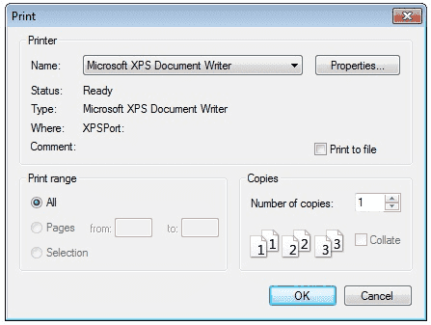
Print Dialog Box
A user can use the Print dialog box to select a printer, configure it, and perform a print job.
Print dialog boxes provide an easy way to implement Print and Print Setup dialog boxes in a manner consistent with Windows standards.

Slide 7
Print Dialog Box
The Print dialog box includes a Print Range group of radio buttons that indicate whether the user wants to print all pages, a range of pages, or only the selected text.
The dialog box includes an edit control in which the user can type the number of copies to print.
By default, the Print dialog box initially displays information about the current default printer.

Slide 8
Print Dialog Box
Drag and drop Print dialog box and button
Double Click the button
Add the code below
private void button1_Click(object sender, EventArgs e)
{
PrintDialog dlg = new PrintDialog();
dlg.ShowDialog();
}

Slide 9
Convert Text to Voice
Create a Windows Application, and can named it as ConvertTextToVoice.
To convert text to speech which is called voice synthesis, you must include "System.Speech" reference in your project.
Click on “References”, then “Add References”.
Click on Framework tab, and then add "System.Speech".

Slide 10
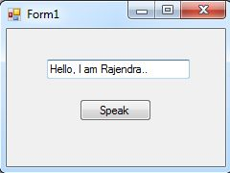
Design Form

Slide 11
Double click on Speak button.
private void Speak_Click(object sender, EventArgs e)
{
SpeechSynthesizer speechSynthesizer = new SpeechSynthesizer();
speechSynthesizer.Volume = 100;
speechSynthesizer.Rate = 0;
speechSynthesizer.SpeakAsync(textBox1.Text);
}

Slide 12
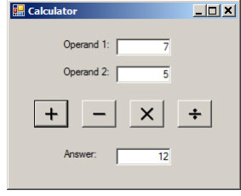
Design a Calculator and write code

